Slide 1
Peer to Peer Network
Notes:
‹#›

Slide 2
Peer to Peer (P2P) System Overview
Significantly autonomous from a centralized authority.
Each node can act as a Client as well as a Server.
Use the vast resources of machines at the edge of the internet.
Storage, content, CPU power, Human presence.
Resources at edge have intermittent connectivity, being added & removed.
Infrastructure is untrusted and the components are unreliable.
Notes:
‹#›

Slide 3
P2P properties
Massive scalability
Autonomy : non single point of failure
Resilience to Denial of Service
Load distribution
Resistance to censorship
Notes:
‹#›

Slide 4
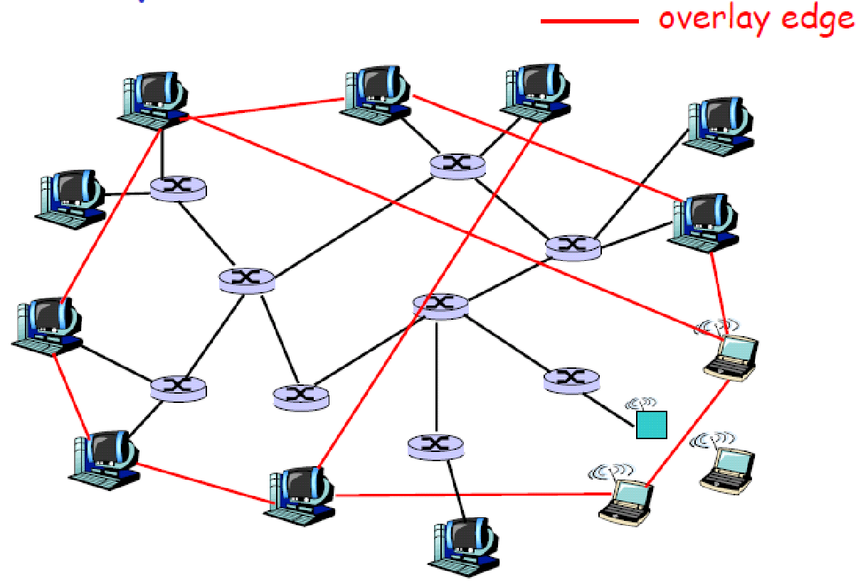
Overlay Network
A P2P network is an overlay network. Each link between peers consists of one or more IP links.
Notes:
‹#›

Slide 5
Overlay Graph (continue)
Virtual edge
TCP connection
or simply a pointer to an IP address
Overlay maintenance
Periodically ping to make sure neighbor is still alive
Or verify aliveness while messaging
If neighbor goes down, may want to establish new edge
Could be a challenge under high churn rate
Notes:
‹#›

Slide 6
Setup P2P Network
Gather the necessary resources like two computers connected the same network.
Install P2P software like Downloa56ude BitTorrent, eMule, and Limewire.
Configure firewall settings to allow P2P traffic
Connect to the P2P network
Share files
Test and troubleshoot (if required)
Notes:
‹#›

Slide 7
Distributed Network
Notes:
‹#›

Slide 8
Overview
Collection of multiple nodes,
Independently run networks that are collectively managed
Every participant can communicate with one another without going through a centralized point
Importance
Provide better reliability
Multiple entry points
Centralized management and monitoring
Uniform policy across the network infrastructure
Notes:
‹#›

Slide 9
Types of Distributed Network
Client-Server: a central server providing services to multiple clients
Peer-to-Peer: each device can act as both client and server
Hybrid: combination of client-server and peer-to-peer
Notes:
‹#›

Slide 10
Use Cases of Distributed Network
Secure Access Service Edge (SASE)
Globally distributed SaaS architectures
Growing in popularity due to remote workforces
Provides network security services for all business traffic flows
Redirects users to alternative head-end locations
Edge computing for IoT
Low-latency network access for collection and analysis of IoT data
Multiple edge compute nodes are required
Notes:
‹#›

Slide 11
Distributed Network Application
File sharing: allows multiple users to access and share files over the network
Cloud computing: allows users to access and store data remotely
Streaming services: deliver audio and video content in real-time
Online gaming: allows multiple players to play together in a virtual environment
Notes:
‹#›

Slide 12
Hardware Used in Distributed Network
Computers: Desktop computers, laptops, and servers
Smartphones: Many distributed networks, such as blockchain networks, allow users to participate using their smartphones
Internet of Things (IoT) devices: Distributed networks can also be run on small devices like sensors and smart home appliances
Cloud servers: Distributed networks can also be run on servers located in data centers, which are connected to the Internet and can be accessed remotely.
Notes:
‹#›

Slide 13
Distributed Network Architecture
Components of a distributed network: multiple networks, communication protocols, routing algorithms
Communication protocols: responsible for transmitting data between the different networks
Routing algorithms: determine the most efficient path for data to travel through the network
Distributed systems all nodes have to trust each others or at least trust a "master" node, where as P2P systems doesn't assume trust between nodes
Notes:
‹#›

Slide 14
Distributed Network Architecture
Components of a distributed network: multiple networks, communication protocols, routing algorithms
Communication protocols: responsible for transmitting data between the different networks
Routing algorithms: determine the most efficient path for data to travel through the network
Notes:
‹#›

Slide 15
Consensus Algorithm
Notes:
‹#›

Slide 16
PoW (Proof of Work)
Consensus algorithm used to secure and validate transactions on a blockchain network. The idea behind PoW is that it requires network participants, known as "miners", to solve complex mathematical problems in order to add new blocks to the blockchain. The process of solving these problems is known as "mining".
Notes:
‹#›

Slide 17
PoW (Continue)
Very secure and resistant to malicious actors
Quite energy-intensive
May not be the best solution for all types of networks
Algorithm is designed to be computationally expensive and time-consuming, making it difficult for a malicious actor to control a majority of the network's computing power and manipulate the blockchain.
Notes:
‹#›

Slide 18
How PoW Works
A new transaction is broadcasted to the network and added to a pool of unconfirmed transactions, known as the "mempool".
Miners take the transactions from the mempool and group them into a block.
The miner must then solve a complex mathematical problem, known as a "hash puzzle", that is specific to the current block. This puzzle is designed to be difficult to solve, but easy to verify.
Once a miner solves the puzzle, they broadcast their solution (known as the "nonce") to the network.
Other miners will then verify the solution and, if it is valid, add the block to the blockchain. The miner who solved the puzzle is rewarded with a certain amount of cryptocurrency for their efforts.
The new block is added to the blockchain and the transactions in it are considered confirmed.
Notes:
‹#›

Slide 19
PoS (Proof of Stake)
Consensus algorithm used to secure and validate transactions on a blockchain network. Instead of using computational power to validate transactions, PoS uses the amount of cryptocurrency held by network participants, known as "validators", to determine who is eligible to add new blocks to the blockchain.
Notes:
‹#›

Slide 20
PoS (Continue)
Designed to be more energy-efficient than PoW, as it doesn't require computational power to validate transactions.
Incentivizes validators to have a stake in the network, as it is in their best interest to keep the network secure.
More vulnerable to a situation called a "nothing at stake" problem, where validators can validate multiple blocks at the same time which can lead to forks
Notes:
‹#›

Slide 21
How PoS Works
When a new transaction is initiated, it is broadcasted to the network and added to a pool of unconfirmed transactions, known as the "mempool".
Validators, who have a certain amount of cryptocurrency "staked" as collateral, are chosen to create a new block. The selection process is based on the validator's stake and sometimes additional factors like randomization.
The chosen validator then adds the transactions from the mempool to a new block and broadcasts it to the network.
Other validators verify the block and, if it is valid, add it to the blockchain. The validator who created the block is rewarded with a certain amount of cryptocurrency for their efforts.
The new block is added to the blockchain and the transactions in it are considered confirmed.
Notes:
‹#›

Slide 22
PoA (Proof of Authority)
Consensus algorithm used to secure and validate transactions on a blockchain network. It is similar to Proof of Stake (PoS) in that it uses a set of designated network participants, known as "validators" or "authorities", to validate transactions and add new blocks to the blockchain. However, unlike PoS, the validators are known and pre-approved identities, rather than chosen based on the amount of cryptocurrency they hold.
Notes:
‹#›

Slide 23
PoA (Continue)
Designed for private or consortium blockchain where the identity of the validators is known and controlled by a specific entity or group.
Can provide a higher level of security and trust, as the validators are known entities that can be held accountable.
Also less decentralized and may not be suitable for certain use cases, such as public blockchains.
Notes:
‹#›

Slide 24
How PoA Works
When a new transaction is initiated, it is broadcasted to the network and added to a pool of unconfirmed transactions, known as the "mempool".
The designated validators, who have been pre-approved and vetted by the network, are chosen to create new blocks.
The chosen validator then adds the transactions from the mempool to a new block and broadcasts it to the network.
Other validators verify the block and, if it is valid, add it to the blockchain. The validator who created the block is rewarded with a certain amount of cryptocurrency for their efforts.
The new block is added to the blockchain and the transactions in it are considered confirmed.
Notes:
‹#›

Slide 25
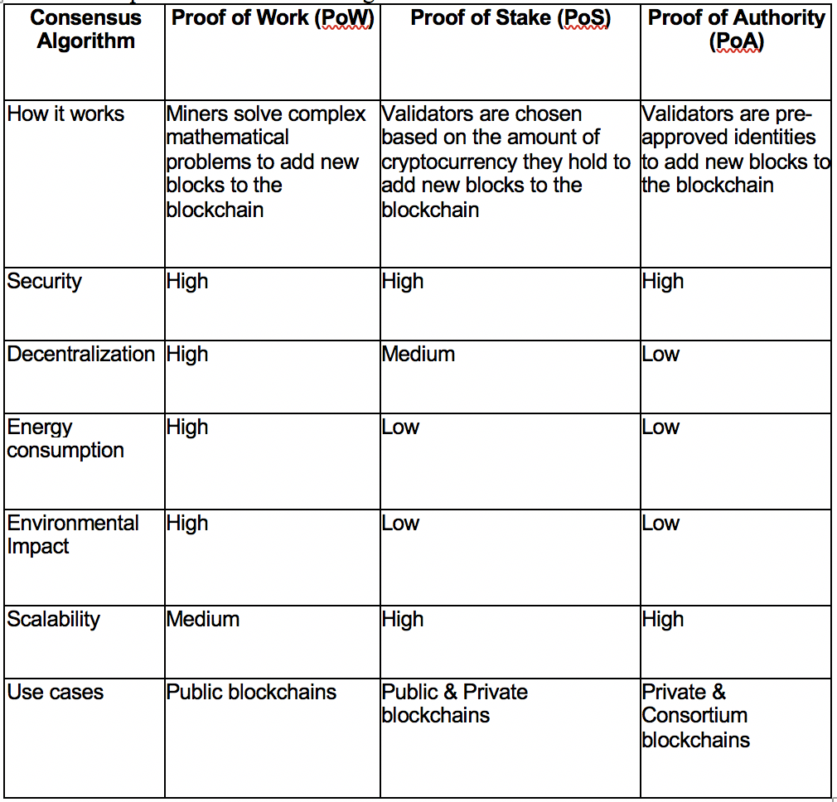
Comparing PoW, PoS, PoA
Notes:
‹#›

